Slide 1



Elevate Your Taste
ChefOnWheels
Culinary Delights at Your Doorstep

Slide 2
Elevate Your Taste
2110030020 - Ch. Sri Chandana
2110030085 - N. Manas
2110030359 - B. Chihnita Reddy
2110030028 - P. Praneeth

Slide 3

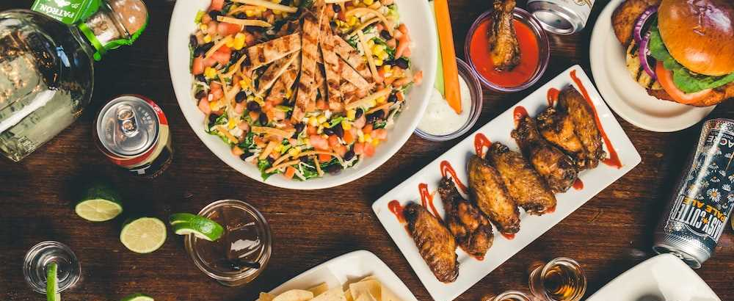
ChefOnWheels
Welcome to Chef on Wheels! We're here to make fancy meals easy. Just tell us when, pick your favorite food, and our chef will cook it in your kitchen. Enjoy a special meal without going out!
No need to stress about cooking or going out—Chef on Wheels brings the restaurant vibe to your home. Experience the joy of a tasty, personalized meal, hassle-free. Elevate your dining moments with us!
Introduction

Slide 4
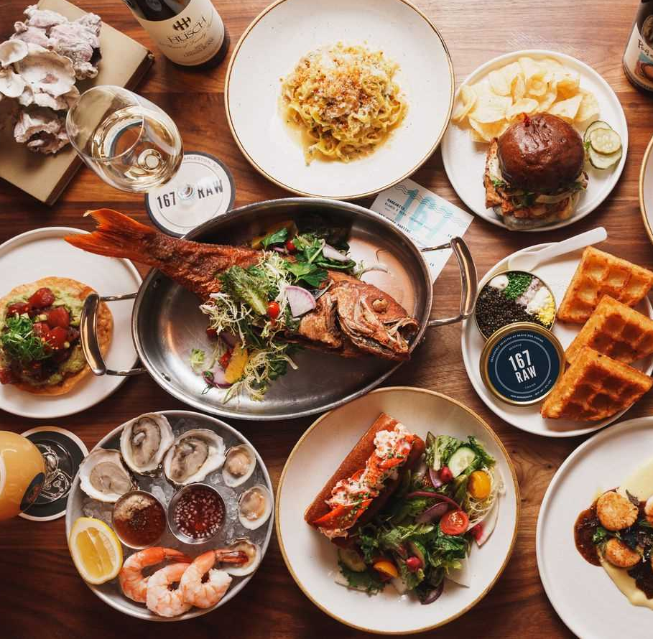
ChefOnWheels
Culinary Delights at Your Doorstep
Convenience Meets Culinary Excellence
A Personal Chef, Just for You
Features
Bringing the Restaurant Experience to Your Home

Slide 5


ChefOnWheels
Customer Booking 📅
Menu Selection 🍲
How it works
Chef Arrival 🚗
Culinary Magic ✨

Slide 6
ChefOnWheels
Chefs can create detailed profiles showcasing their culinary expertise, specialties, and past experiences. This allows them to market their skills to a broader audience.
Customers can collaborate with chefs to create personalized menus tailored to their preferences, dietary restrictions, and the theme of the event.
Popularity
Chefs are compensated based on the amount of food cooked and the time spent on the service. This transparent payment structure ensures fair compensation for chefs.
Customers can book chefs based on their availability and schedule. Whether it's for a daily meal, hourly service, weekly engagements, or monthly contracts, the platform provides flexibility.

Slide 7

ChefOnWheels
Novelty
Convenience without Compromise
Personalization at Its Best
Time-Efficient Solution
Interactive Cooking Experience

Slide 8
ChefOnWheels
Growth Of Project
Identify new geographic areas or target demographics where the demand for personalized culinary experiences is high.
Explore partnerships with local businesses, event planners, or hospitality establishments to expand the reach of Chef on Wheels.
Introduce new services or offerings to cater to a broader audience. This could include special packages, themed events, or collaborations with other service providers.
Technology Enhancements: Continuously invest in improving the technology platform to enhance user experience, streamline operations, and stay competitive in the online marketplace.

Slide 9

Chef on Wheels: Elevating dining with a dash of innovation and a sprinkle of personalized flair, all served conveniently at your doorstep
THANK YOU

